Slide 1

Anomaly Detection on loT Network Intrusion Using Machine Learning
Project Presentation On
19 May, 2021
Presented To
Dr. Bhawana Rudra
Presented By
Nitin Sharma -202IT017

Slide 2

AGENDA
Abstract
Introduction
Wireshark
Environment Details
Dataset Details
Implementation Goals
Goal 1 : Dataset Generation
Goal 2 : Dataset Preprocesing
Goal 3 : Hyper-parameter Tuning
Goal 4 : Prediction Model
Result Comparison with Paper
Conclusion

Slide 3
ABSTRACT
With increase in IOT equipped devices in all the fields, large scales of loT devices are being developed and deployed.
This increases need for these devices to communicate securely without compromising performance, which is very challenging.
Most of the IOT based devices run on low power supply which hinders from applying encryption and authentication as they are computation rich tasks.
So how can we safeguard our devices? : focus on out-of-ordinary requests on devices
AIM : To build different machine learning models to detect anomalies in network intrusion dataset and then perform performance comparison analysis of these models.

Slide 4
LITERATURE SURVEY
Extensive research in this field has been done in previous years with data scientists exploring different datasets to different ML techniques to better understand. Two papers that I have referred for my work are :
[August 2020] Anomaly Detection on IoT Network Intrusion Using Machine Learning : worked on 5 different algos and achieved an accuracy of 100%.
[September 2019] Attack and anomaly detection in IoT sensors in IoT sites using machine learning approaches
performances of several machine learning models have been compared to predict attacks and anomalies on the IoT systems accurately.
5 different machine learning (ML) algorithms have been used here and achieve highest accuracy of 99%.

Slide 5
INTRODUCTION - IOT
“a dynamic global network infrastructure with self configuring capabilities based on, existing and evolving, interoperable information and communication technologies, where physical and virtual ’Things’ have identities, physical attributes, and virtual personalities and use intelligent interfaces, and are seamlessly integrated into the information network, to connect and communicate within social, environmental, and user contexts”
IOT technologies has been widely explored in recent years and with increase of number of devices communicating over internet, it becomes highly important to secure communication over these channels.
Applications : Health, Traffic monitoring, Fire detection, Agriculture, Autonomous driving, Military, Nuclear power plants, etc.

Slide 6
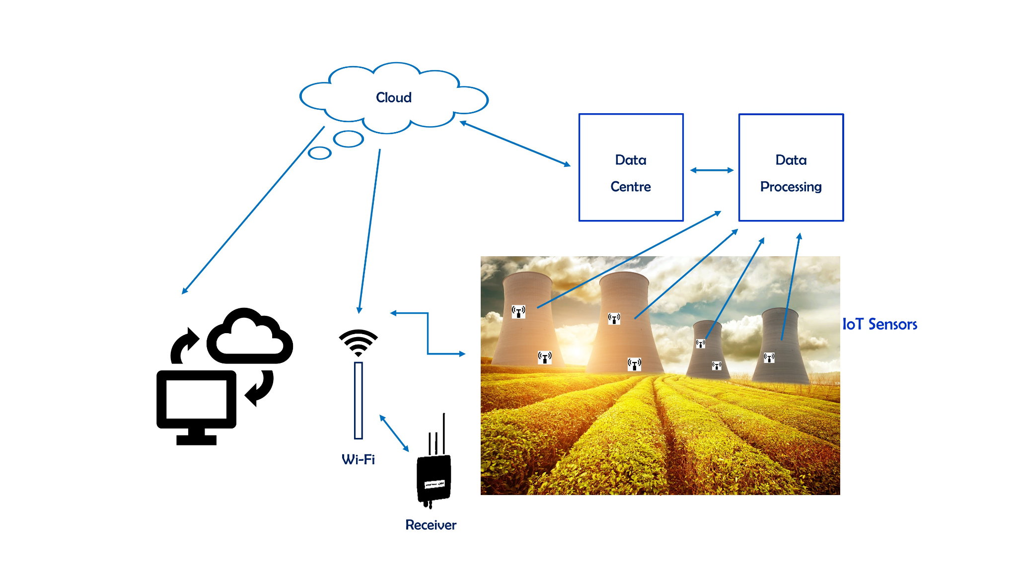
INTRODUCTION - IOT EXAMPLE

Slide 7

INTRODUCTION - IOT CHALLENGES
Insufficient testing and updating
Concern regarding data security and privacy
Software complexity
Data volumes and interpretation
Integration with AI and automation
Devices require a constant power supply which is difficult
Interaction and short-range communication

Slide 8

WIRESHARK
Wireshark is a network packet analyzer which presents captured packet data in as much detail as possible.
Some Applications :
Network administrators use it to troubleshoot network problems.
Network security engineers use it to examine security problems.
Developers use it to debug protocol implementations
TShark : a CLI network protocol analyzer which lets you capture packet data from a live network, or read packets from a previously saved capture file, either printing a decoded form of those packets to the standard output or writing the packets to a file.

Slide 9



DATASET AND WORKING ENVIRONMENT
Network Intrusion Dataset
System Setup
Google colab environment
Network Intrusion Dataset from OCSLAB
Language : Python
File Format : pcap
Total Files : 42 raw files
Each file containing multiple categories of packets
Categories : 2 (Normal/Malicious)
Filter Rule File : details on rules to extract packets in readable form from pcap files.

Slide 10
DATASET DISTRIBUTION
Category | Sub-category | No of Packets
Normal | Normal | 1,756,276
Scanning | Host Discovery | 2,454
Scanning | Port Scanning | 20,939
Scanning | OS/Version Detection | 1,817
Man in The Middle | ARP Spoofing | 1,01,885
Denial of Service | SYN Flooding | 64,646
Miral Botnet | Host Discovery | 673
Miral Botnet | Telnet | 1,924
Miral Botnet | UDP Flooding | 9,49,284
Miral Botnet | ACK Flooding | 75632
Miral Botnet | HTTP Flooding | 10464
Due to computation power constraint, I will be consider 5000 samples of packets for whole evaluation.

Slide 11

IMPLEMENTATION GOALS
Implementation goals includes :
Dataset Generation : extract relevant data from pcap files
Data pre-processing : removal of erroneous data
ML-Model creation and training
Model hyperparameter tuning : manually for ANN and using GridSearch for rest of the models
Prediction and Testing
Performance Evaluation and Comparison
Evaluation Metrics : Accuracy, F1 score, Recall score

Slide 12
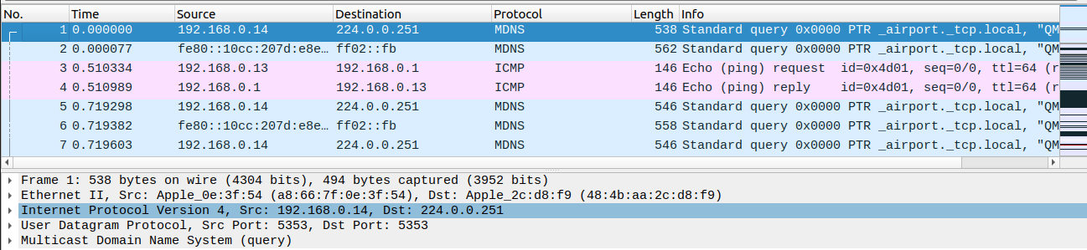
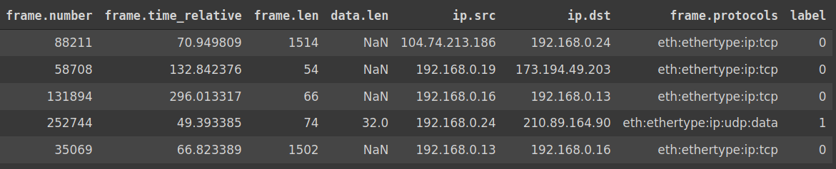
DATASET GENERATION
Pcap file uploaded on Wireshark
Extracted Information from T-shark

Slide 13
DATASET GENERATION : STEPS
Learn Wireshark and Tshark command line interface for pcap file processing
Extract features from data packets in pcap files
Filter files by rules to separate attack from normal packets using filter rules.
Repeat the process for all 42 files Combine all csv files using concatenation into Normal.csv and Attack.csv.
Label the attacks and combine csv files and remove redundant data

Slide 14
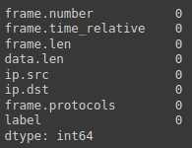
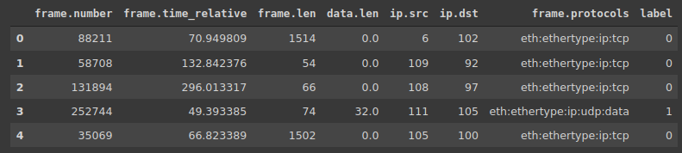
DATASET PREPROCESSING - 1/2
Step 1 : Check for Null values
Step 2 : Delete records with Nan values for ‘ip.src’ and ‘ip.dst’.
Step 3 : Replace null values for ‘data.len’ attribute with 0 method.
Step 4 : Label Encoding ‘ip.src’ and ‘ip.dst’

Slide 15
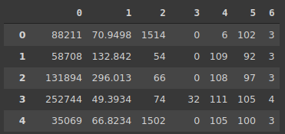
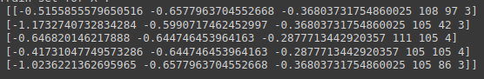
DATASET PREPROCESSING - 2/2
Step 5 : Processing protocol name and Label Encoding Protocols
Step 6 : Feature scaling column 1,2,3

Slide 16

MACHINE LEARNING MODELS
Machine Learning models that were developed are :
Logistic Regression
K Nearest Neighbors
Random Forest
Support Vector Machine
Decision Tree (My Contribution)
Naive Bayes (My Contribution)
Artificial Neural Network (My Contribution)

Slide 17
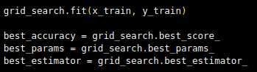
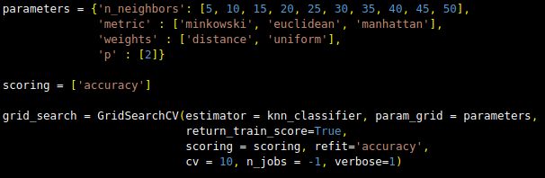
MODEL PARAMETER TUNING
For parameter tuning of Logistic Regression, K Nearest Neighbors, Random Forest, Support Vector Machine and Decision Tree, GridSearch with 10-fold cross validation was used.
In case of Naive Bayes, there are no as such parameters to be tuned and in case of ANN manual parameter tuning was done as Gridsearch does not work for it.
[Sample Grid-Search Code]

Slide 18
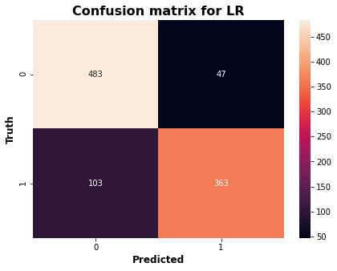
MODEL 1 : LOGISTIC REGRESSION
Metric | Our Score | Paper Score
Accuracy | 0.8493 | 0.86
F1 Score | 0.8287 | 0.80
Recall | 0.7789 | 0.75

Slide 19
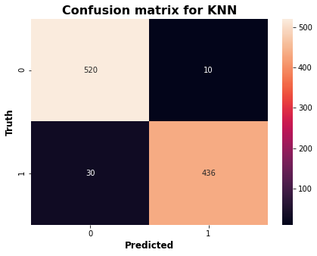
MODEL 2 : K-NEAREST NEIGHBOURS
Metric | Our Score | Paper Score
Accuracy | 0.96 | 0.99
F1 Score | 0.9561 | 0.99
Recall | 0.9356 | 0.96

Slide 20
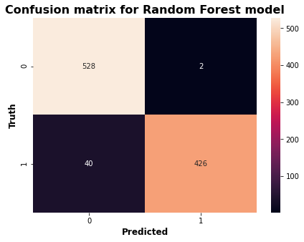
MODEL 3 : RANDOM FOREST
Metric | Our Score | Paper Score
Accuracy | 0.9578 | 1
F1 Score | 0.9530 | 1
Recall | 0.9141 | 1

Slide 21

MODEL 4 : SUPPORT VECTOR MACHINE
Metric | Our Score | Paper Score
Accuracy | 0.9518 | 0.79
F1 Score | 0.9467 | 0.77
Recall | 0.9163 | 0.78

Slide 22
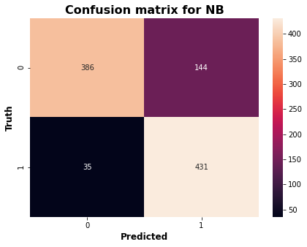
MODEL 5 : NAIVE BAYES
Metric | Our Score | Paper Score
Accuracy | 0.8202 | -
F1 Score | 0.8289 | -
Recall | 0.9248 | -

Slide 23
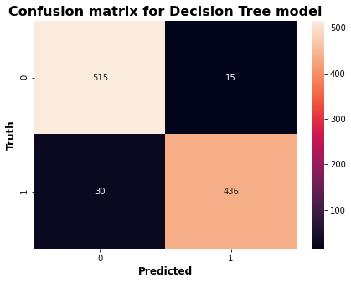
MODEL 6 : DECISION TREE
Metric | Our Score | Paper Score
Accuracy | 95.48 | -
F1 Score | 95.09 | -
Recall | 93.56 | -

Slide 24
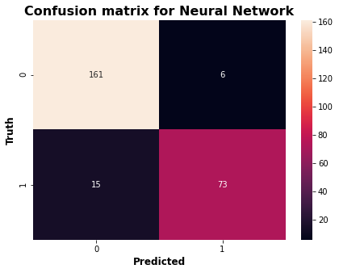
MODEL 7 : NEURAL NETWORK
Metric | Our Score | Paper Score
Accuracy | 0.918 | -
F1 Score | 0.874 | -
Recall | 0.83 | -

Slide 25
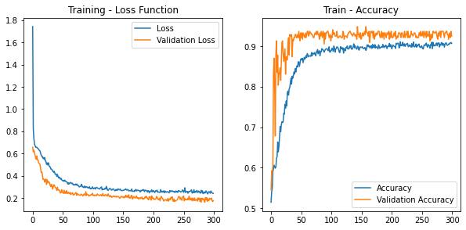
MODEL 7 : NEURAL NETWORK

Slide 26
CONCLUSION
In our project we tried to enhance IOT security by building ML based models and testing network intrusion dataset on it.
I achieved highest accuracy of 0.96 for KNN model with 0.95 f1 score and 0.94 recall.
Base paper had highest score of 1 for all three metrics in case of Random Forest.
My accuracy even though is less compared to the base paper, but still is fairly good.
Further study may involve finding better ways to encode ip addresses and perform same experiments in high performance systems so that full dataset can be utilized.
Also, Classification into different types of attacks can be performed.

Slide 27
REFERENCES
Base Paper : Anomaly Detection on IoT Network Intrusion Using Machine Learning
https://ieeexplore.ieee.org/document/9183842
Reference Paper : Attack and anomaly detection in IoT sensors in IoT sites using machine learning approaches
https://www.sciencedirect.com/science/article/pii/S2542660519300241
Wireshark documentation : https://www.wireshark.org/docs/wsug_html_chunked/ChIOOpenSection.html
Tshark tutorial :
https://hackertarget.com/tshark-tutorial-and-filter-examples/

Slide 28
REFERENCES
Dataset :
https://ocslab.hksecurity.net/Datasets/iot-network-intrusion-dataset
Code File : anomaly-detection-dataset-creation : Dataset Creation https://colab.research.google.com/drive/1rxQypSQ_22PnkOfWJoBDQXaSo5OkO3oX?authuser=2#scrollTo=6IYWuoT4lDii
Code File : anomaly-detection-pre-process-and-prediction : Rest of the code https://colab.research.google.com/drive/1rSGC1zH8M_ANtFLje8Y4urn6qWuyynS7?authuser=2#scrollTo=mBhwtDJhWAQj

Slide 29
THANK YOU!

